Slide 1
Cybersecurity Fundamentals

Slide 2
Introduction to Information Security
What is Information Security?
Protection of information from unauthorized access, use, disclosure, disruption, modification, or destruction.
Ensures confidentiality, integrity, and availability (CIA Triad).
Example: Protecting login credentials from being shared or stolen.

Slide 3
Why is Information Security Important?
Safeguards sensitive data (e.g., personal, financial, and health information).
Prevents identity theft and fraud.
Protects business assets and reputation.
Ensures compliance with laws and regulations (e.g., GDPR, HIPAA).
Example: A healthcare provider encrypting patient records to comply with HIPAA regulations.

Slide 4
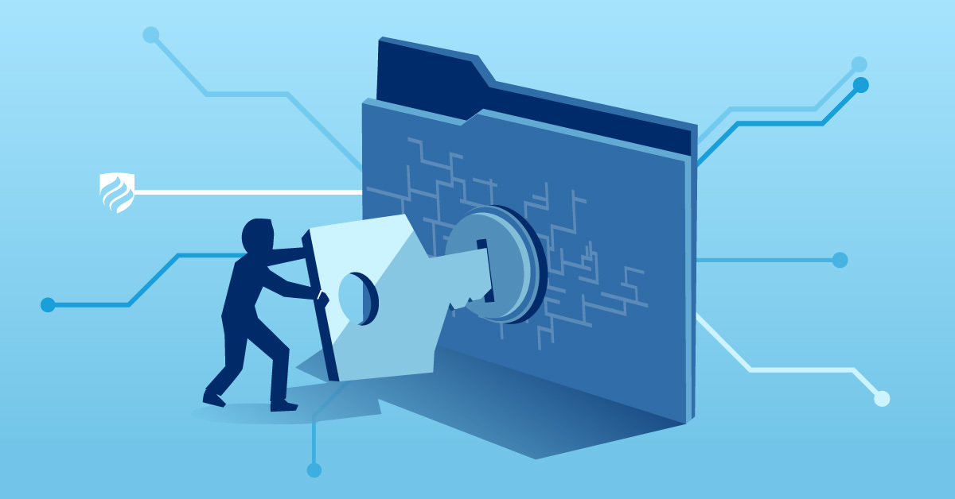
Information Security v/s Cyber Security

Slide 5
Hack
Cutting something into pieces by sheer force
Doing anything in an unconventional way or in a shortcut way

Slide 6
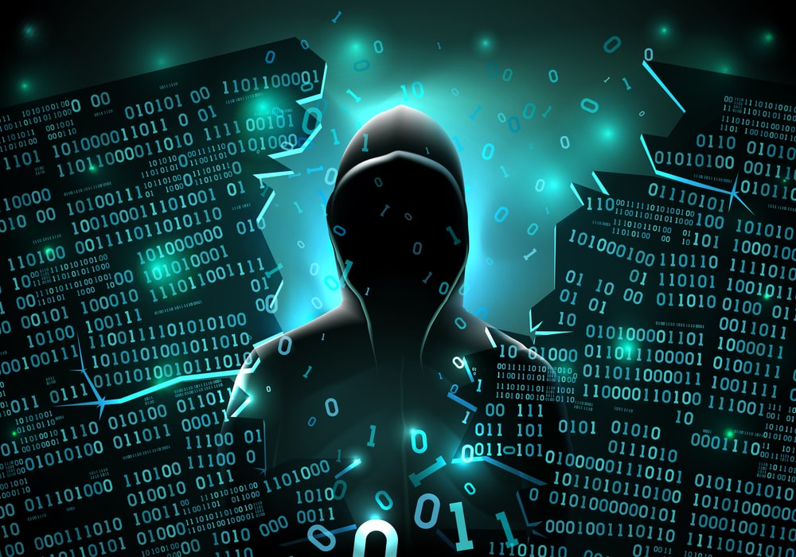
Hacker and Types of Hacker
Black hat
White hat
Gray hat
Script kiddies
Suicidal hackers
State-sponsored hackers
Cyberterrorists
Hacktivists
Insider Threats
Advanced Persistent Threat (APT)

Slide 7
Common Threats
Malware: Viruses, worms, and ransomware.
Phishing: Deceptive emails to steal sensitive information.
Physical Theft: Devices being stolen or misplaced.
Social Engineering: Manipulating individuals to divulge confidential information.
Denial-of-Service (DoS) Attacks: Overloading systems to make services unavailable.
Man-in-the-Middle (MitM) Attacks: Intercepting communication between two parties.
SQL Injection: Exploiting vulnerabilities in databases to steal or manipulate data.
Zero-Day Vulnerabilities: Exploiting unknown software vulnerabilities.
Data Breaches: Unauthorized access to sensitive data.
IoT Vulnerabilities: Exploiting weak security in Internet of Things devices.
Unpatched Software: Exploiting known vulnerabilities in outdated software.
Rogue Access Points: Unauthorized wireless access points allowing network intrusion

Slide 8
Basic Security Terminologies
Vulnerability
Exploit
Attack
Payload
Asset
Asset value
Hack value
Risk
Threat
Bot
Bot-net
Trojan
Daisy chaining
Personally identifiable information
Doxing

Slide 9
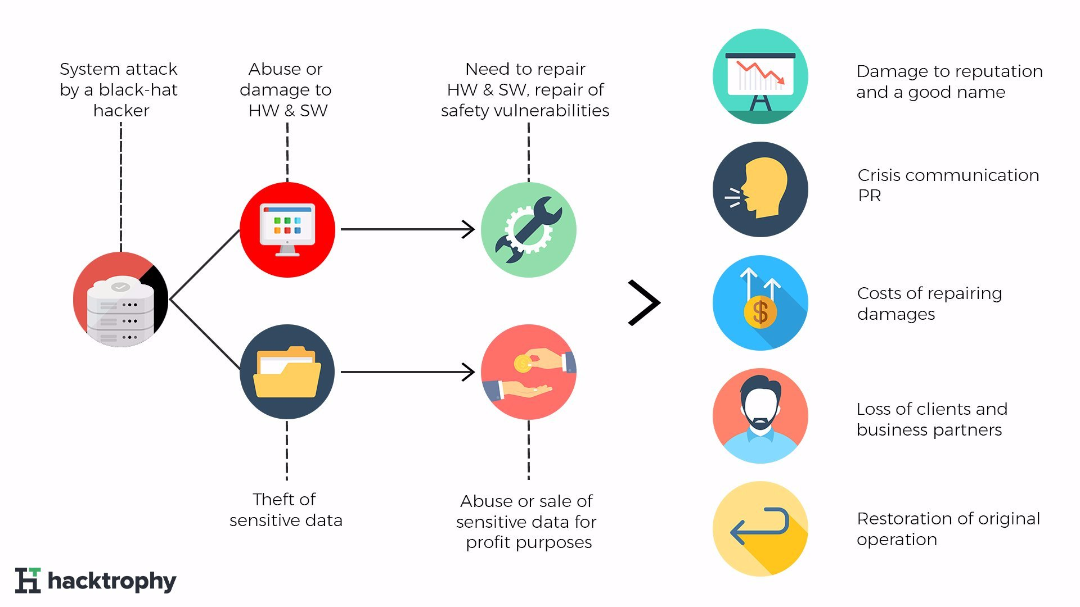
Impacts of Hack
Reputational impact
Operational impact
Financial impact
Legal impact

Slide 10
Elements of Information Security
Confidentiality
Integrity
Availability
Authenticity
Non-Repudiation

Slide 11
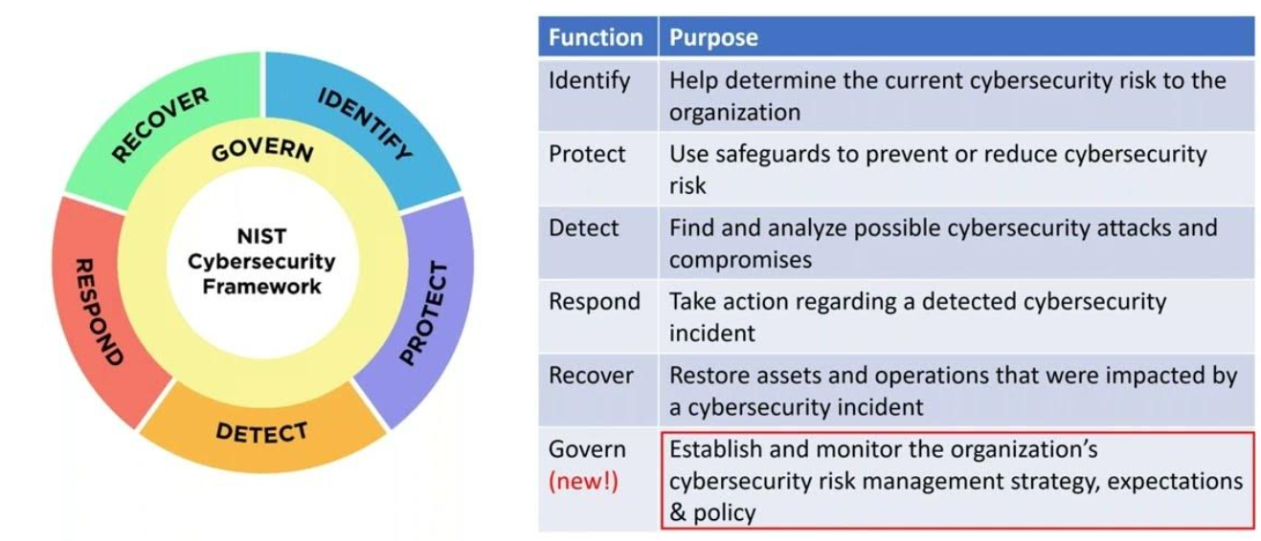
NIST Cyber Security Framework

Slide 12
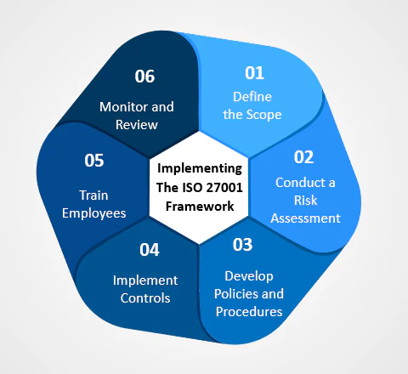
ISO/IEC 27001 Framework

Slide 13
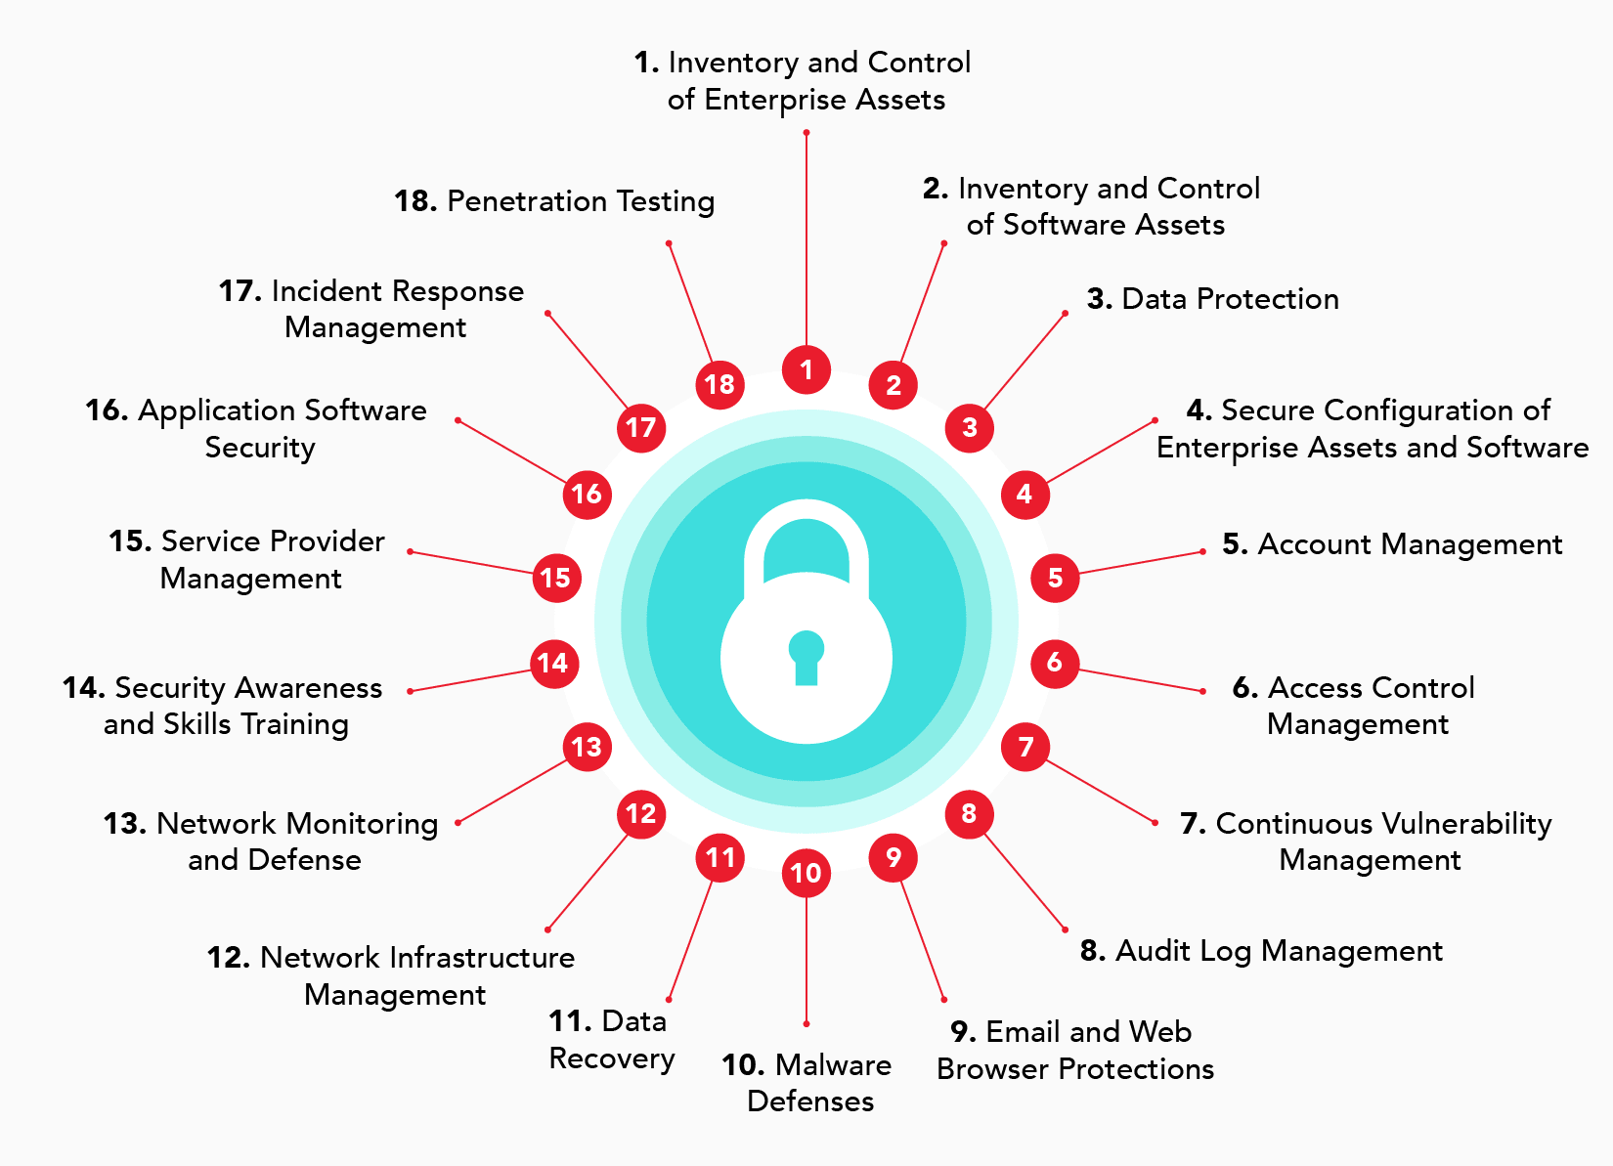
CIS Critical Security Controls (CIS CSC)

Slide 14
Identity and Access Management (IAM)

Slide 15
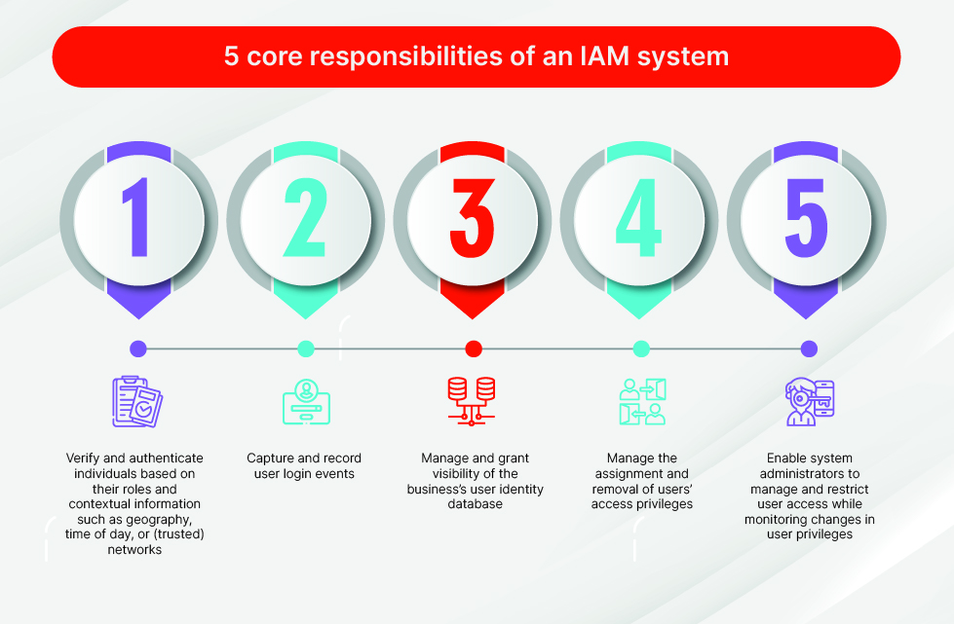
Identity and Access Management (IAM)
Identity and Access Management (IAM) is a security framework that ensures the right person gets the right access to the right resource at the right time.
Identity = Who are you? (user, employee, admin, app, service)
Access = What are you allowed to do? (read, write, delete, approve)
IAM is used in organizations, cloud platforms, applications, networks, and databases to control user access securely.

Slide 16
Core Components of IAM
Identity: A user or system that needs access.
Authentication: Verifying the identity of users.
Authorization: Granting access to resources.
IGA – Identity Governance & Administration: ensures that access is appropriate, approved, and regularly reviewed for compliance
SoD – Segregation of Duties: Ensures that critical or conflicting tasks are divided among multiple users
CIAM – Customer Identity & Access Management: Manages identities and access for external users such as customers and partners
Privileged Access Management (PAM): Secures and monitors high-privilege accounts such as administrators and root users
Single Sign-On (SSO): Allows users to authenticate once and gain access to multiple applications
Accounting (Audit, Logging, and Monitoring): Tracking and recording user activities.

Slide 17
Authentication
The process of verifying who you are.
Methods:
Something you know: Passwords, PINs.
Something you have: Smart cards, tokens.
Something you are: Biometrics (fingerprint, facial recognition).
Example: Logging into a bank account using a password and OTP.

Slide 18
Authorization
Determining what actions a user is allowed to perform.
Key Concepts:
Role-based access control (RBAC).
Least privilege principle.
Access control lists (ACLs).
Example: A marketing employee accessing customer data but not financial records.

Slide 19
Accounting
Tracking and logging user activities.
Purpose:
Monitoring resource usage.
Auditing for security and compliance.
Detecting anomalies and incidents.
Example: Logging IP addresses and timestamps for VPN sessions.

Slide 20
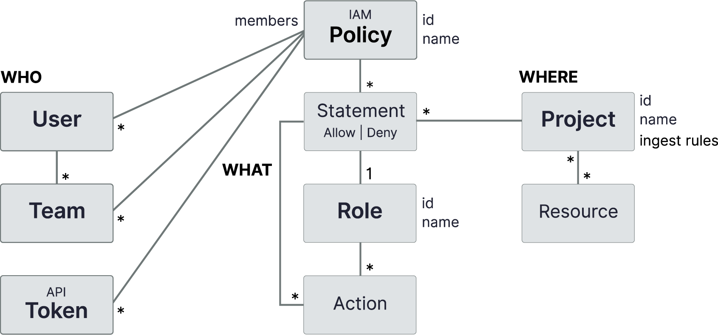
IAM Policies
An IAM policy is a set of rules that defines:
Who can access a resource
What actions they can perform
On which resources
Core Components of an IAM Policy
1. Subject (Who)
2. Action (What)
3. Resource (On What)
4. Effect (Allow or Deny)
5. Condition (When / How)

Slide 21
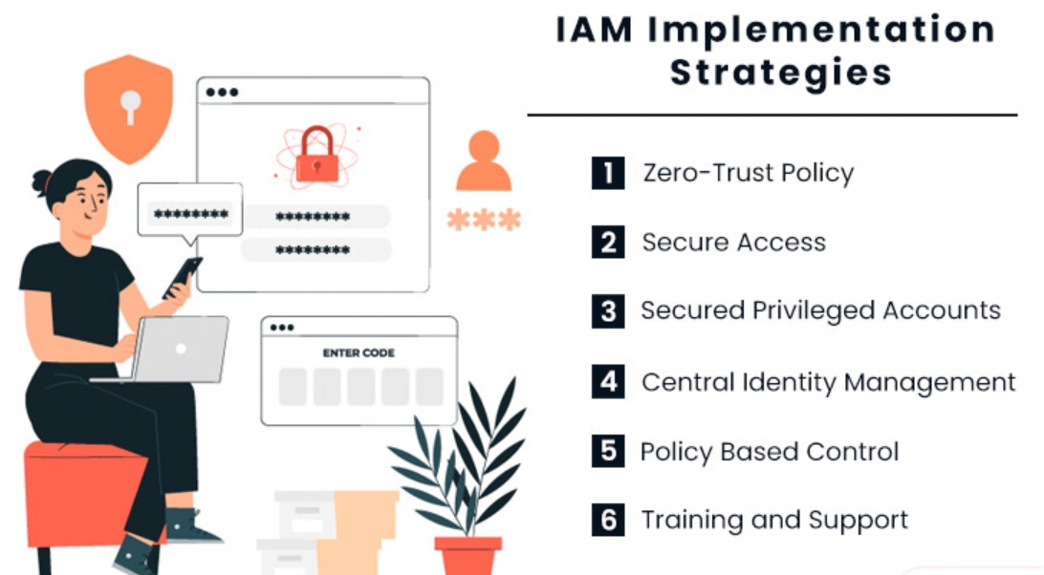
Types of IAM Policies
1. Identity-Based Policies
2. Resource-Based Policies
3. Role-Based Access Control (RBAC) Policies
4. Attribute-Based Access Control (ABAC)
5. Privileged Access Policies

Slide 22
IAM Lifecycle (Identity and Access Management)
IAM lifecycle defines how a user’s digital identity and access rights are created, managed, monitored, and removed across systems during their association with an organization.
1. Identity Creation
2. Provisioning (Access Assignment)
3. Authentication (Identity Verification)
4. Authorization (Access Enforcement)
5. Access Review & Monitoring (Governance Phase)
6. Privileged Access Management (PAM)
7. Identity Modification (Mover Phase)
8. De-Provisioning (Leaver Phase)
9. Audit, Compliance & Reporting

Slide 23


